Slide 1
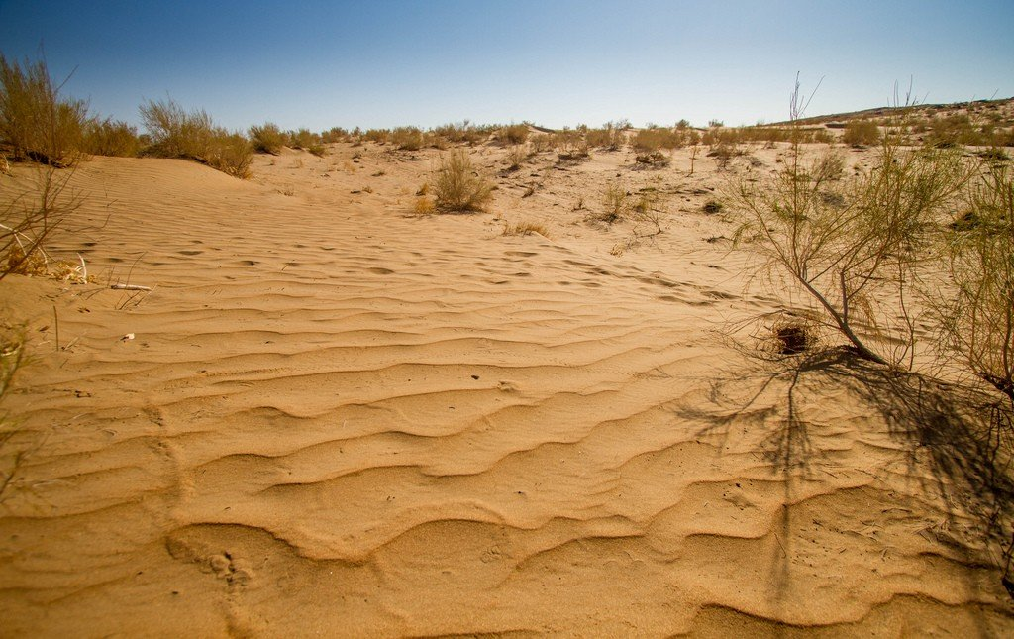


Full itinerary and detailed information about the trip.
From Antiquity to Sunset: Desert Tour
BEST CHOICE
BEST PRICES
RELIABLE TEAM

Slide 2

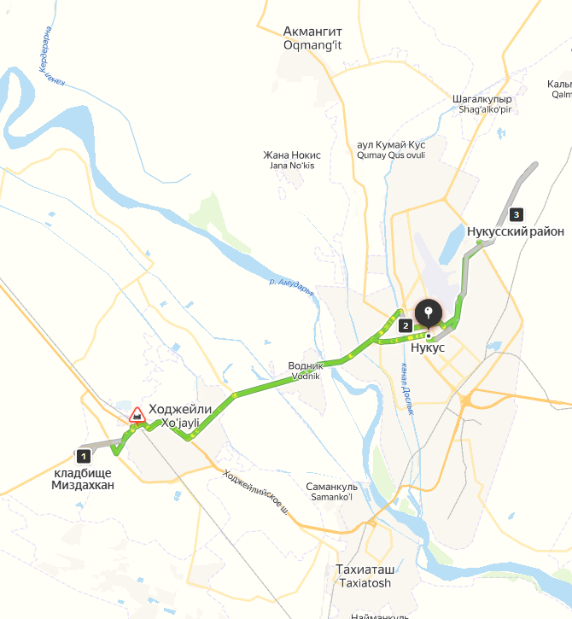
Trip itinerary
Duration:
2 days/1 night
Tour season:
Year-round
Total distance:
More than 100 km
Meals:
3 times
Transport:
Off-road vehicle 4x4

Slide 3

Day 1: Nukus – Mizdakhkan – Nukus – Kyzyl Kum Desert
Start point:
Nukus city (Railway Station, Airport, Hotel, etc.)
8:00 AM – Pickup from Nukus
Start your adventure with a 4x4 SUV transfer from your hotel in Nukus.
8:30 AM – 10:00 AM – Visit Mizdakhan Necropolis
Explore this ancient cemetery and archaeological site, rich in history and legends.
10:30 AM – 11:30 AM – Horseback Riding Adventure
Enjoy a guided horseback ride at a nearby horse field. This activity provides a unique way to connect with local equestrian traditions. Riders of all experience levels are welcome.
12:00 PM – 1:30 PM – Lunch in a Traditional Guesthouse
Lunch will be served in a traditional guesthouse, offering an authentic local experience.
2:00 PM – 3:30 PM – Cinema Experience in Nukus
After lunch, enjoy a special cinema session in Nukus, featuring:
The Savitsky Museum and its world-renowned art collection.
The unique Karakalpak lifestyle and traditions.
The history and environmental impact of the Aral Sea.
4:00 PM – Arrival at the Desert
Drive to the desert area near Nukus. Enjoy a scenic stop to take in the vast, serene landscapes of the Karakalpak desert.
4:30 PM – 5:30 PM – Jeep Ride in the Desert
Hop into a 4x4 jeep for an exhilarating ride through the desert dunes. Feel the thrill as you navigate the vast landscape, getting a firsthand experience of the desert’s rugged terrain.
5:30 PM – 6:30 PM – Cultural Show Concert
Enjoy a vibrant performance by local musicians and dancers in the heart of the desert. Experience Karakalpak traditions through music, dance, and storytelling.
6:30 PM – 7:00 PM – Photo Session in Traditional Clothes
Dress in beautiful Karakalpak traditional attire for a professional photo session amidst the dramatic desert backdrop.
7:00 PM – 7:30 PM – Sunset Over the Desert
Witness the magical hues of the desert sunset while sipping on refreshing beverages.
7:30 PM – 9:00 PM – Dinner Around the Campfire
End your day with a delightful dinner under the stars, seated around a warm campfire in the desert. Enjoy traditional Karakalpak dishes and share stories of the day’s adventures.
9:00 PM – 10:00 PM – Return to Nukus
Conclude your adventure with a drive back to Nukus, where you'll be dropped off at your hotel or chosen location.
Day 2: 09:00 Return to Nukus

Slide 4
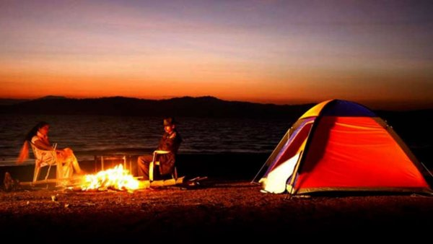
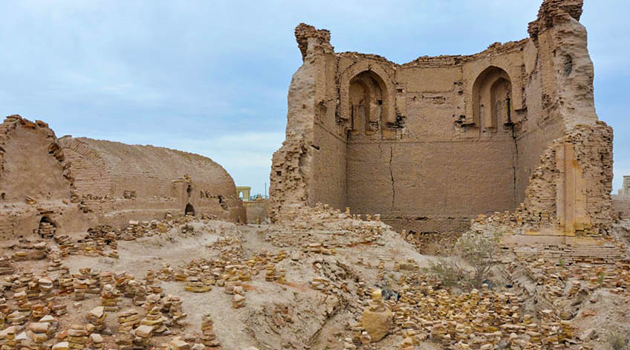
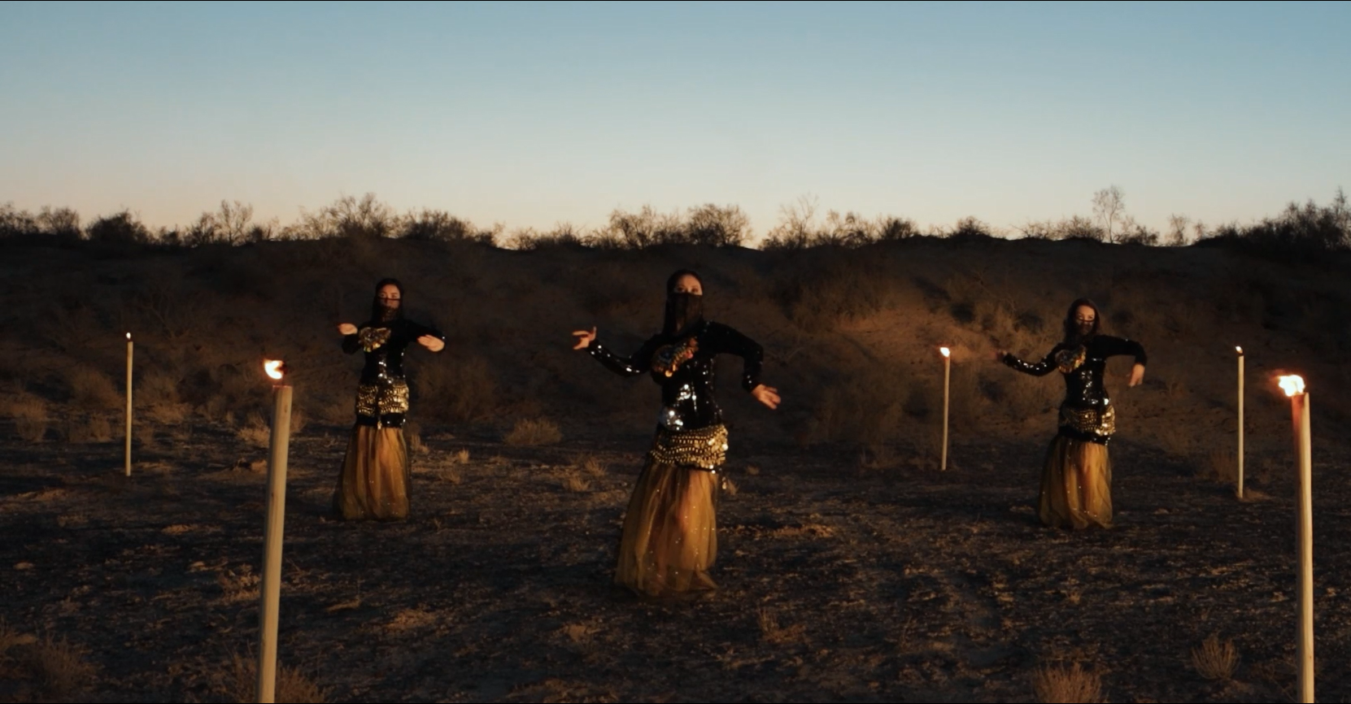
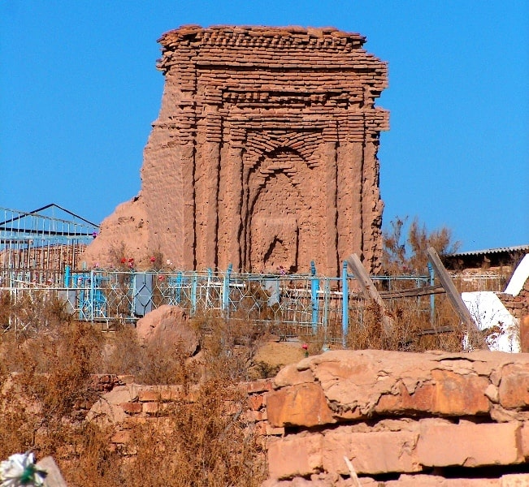
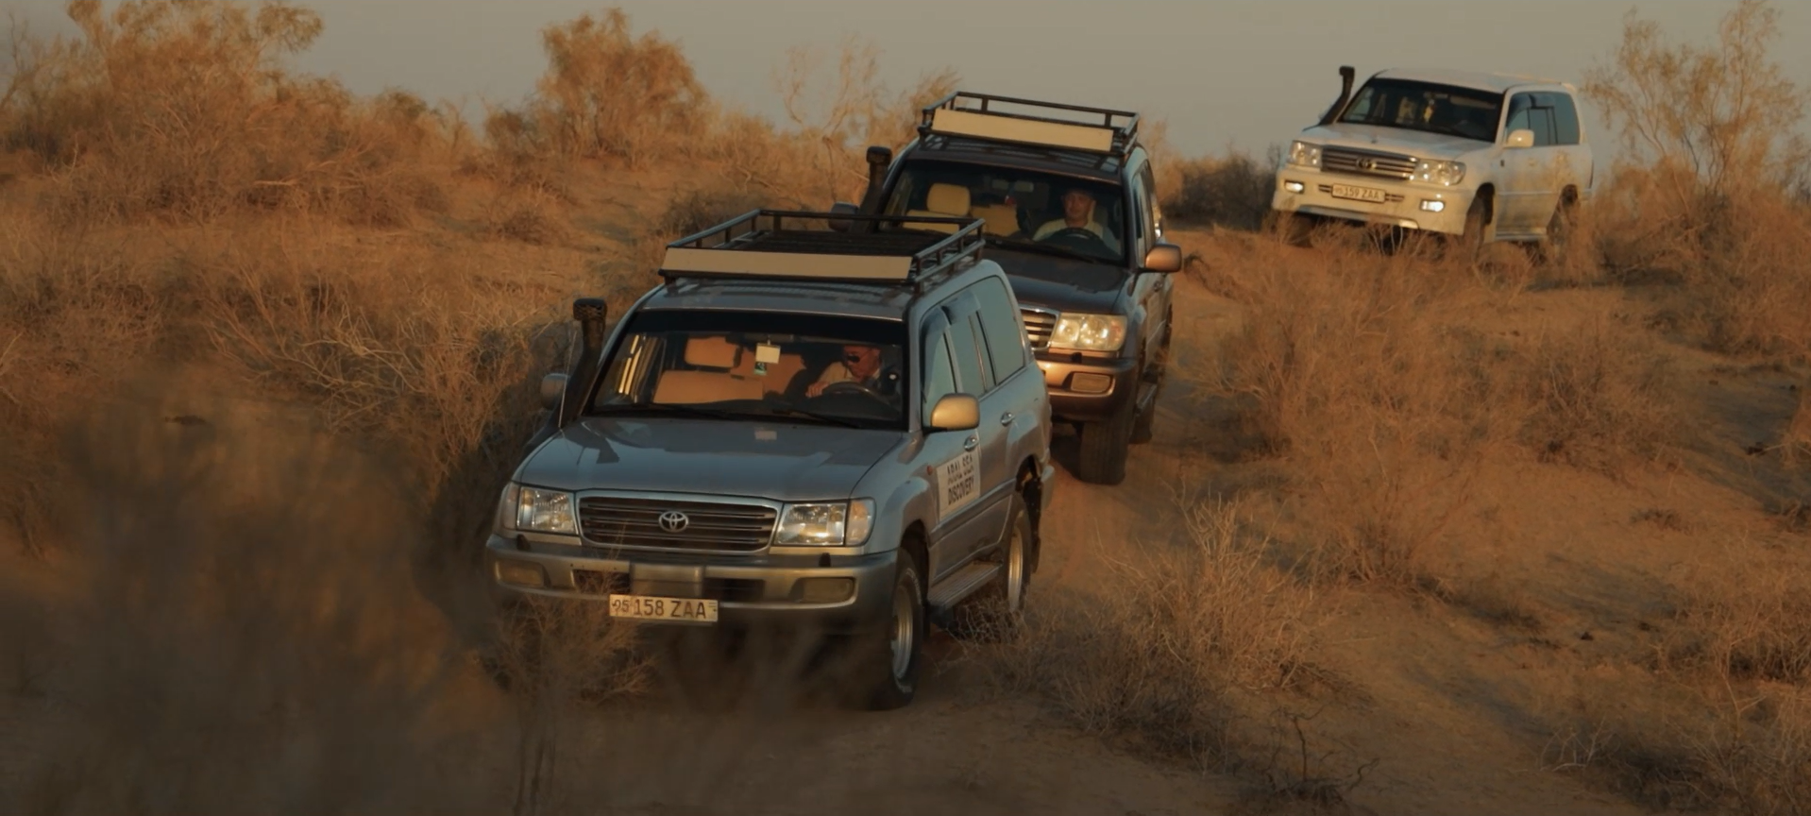
www.besqala.com

